Slide 1

WIPRO NGA Program – DWS
Capstone Project Presentation – 17th June & 18th June
2025
Project Title Here - Insert Custom Actions in MSI
Presented by - Siddhesh Subhash Bordekar
www.rpsconsulting.in

Slide 2

2
Introduction
This project demonstrates how to insert custom actions into an MSI installer using the PowerShell App Deployment Toolkit (PSADT). Custom actions allow the installer to run PowerShell scripts or commands before, during or after installation/uninstallation. This enhances deployment control, enables UI prompts and improves user experience. It is especially useful for enterprise scenarios like certificate checks, pre-install validations or clean-up tasks.
2024 - RPS Consulting all rights reserved

Slide 3
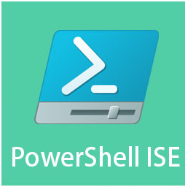
3
Project Requirement
Operating System: Windows 10 / 11
Development Environment:
Windows PowerShell ISE (for scripting and testing)
PSAppDeployToolkit (PSADT) (for GUI and scripting framework)
Notepad / Visual Studio Code (Optional)
2024 - RPS Consulting all rights reserved

Slide 4
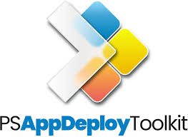
4
Introduction to Tools
PowerShell ISE: Used to write and test deployment scripts.
PSAppDeployToolkit (PSADT): A framework for creating user-friendly, professional software deployments with GUI elements like prompts, dialogs, and progress bars.
MSI Installer: Acts as the deployment package; custom actions are inserted via script integration
2024 - RPS Consulting all rights reserved

Slide 5
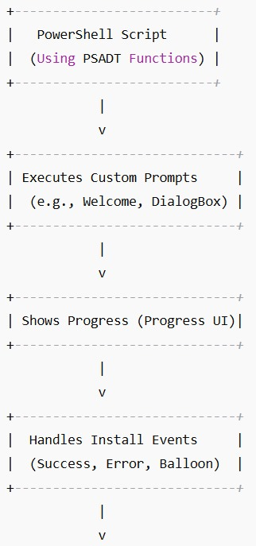

5
Flowchart Diagram
Start Script: Runs the deployment script containing custom actions. Show Welcome: Greets the user with information and closes conflicting apps. Prompt for Confirmation: Asks if user wants to proceed (custom buttons). Dialog Boxes: Show alerts, errors or instructions. Progress Indicator: Shows graphical progress while MSI installs. Tray Notification: Displays a balloon tip for completion or errors. Installation Ends: Completes the install process.
2024 - RPS Consulting all rights reserved

Slide 6
6
Usage Process
Install PSADT and extract it to a working directory.
Open PowerShell ISE and load the Add-AppDevPackage.ps1 script.
Modify the script to insert custom GUI interactions using these PSADT commands.
Run the script in PowerShell to test custom actions.
Verify behavior during install, uninstall or error scenarios.
2024 - RPS Consulting all rights reserved

Slide 7
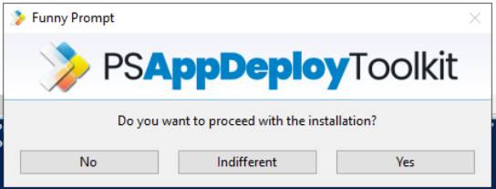
7
Execution Overview Steps
Show-ADTInstallationPrompt Displays a prompt with customizable buttons.
Show-ADTInstallationWelcome Shows a welcome dialog with process names to close or options to defer installation.
Show-ADTInstallationProgress Displays a progress bar while installation executes in the background.
Show-ADTDialogBox Shows alerts, error messages or confirmation boxes with Yes/No or OK/Cancel buttons.
Show-ADTBalloonTip Displays a tray notification for eg. "Installation Started", "App Installed Successfully".
All functions are called from within Add-AppDevPackage.ps1 and work together to guide users through a more interactive, safe install process.
2024 - RPS Consulting all rights reserved

Slide 8
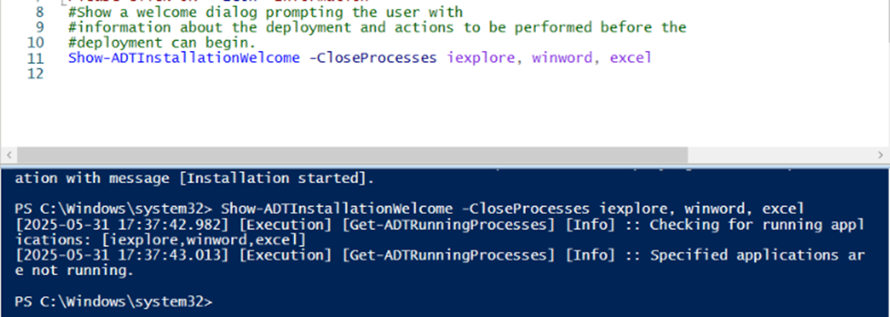
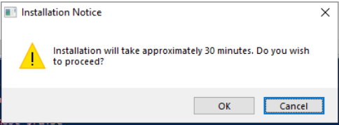
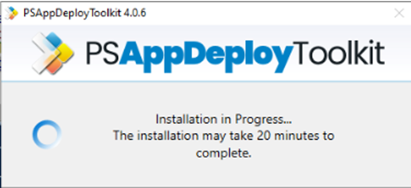
8
Analysis Result
Script Execution: Successful installation with all GUI prompts and logs.
User Interaction: Highly improved with dialog boxes, welcome screens, and balloon tips.
System Performance: No heavy resource usage or crashes observed.
2024 - RPS Consulting all rights reserved

Slide 9
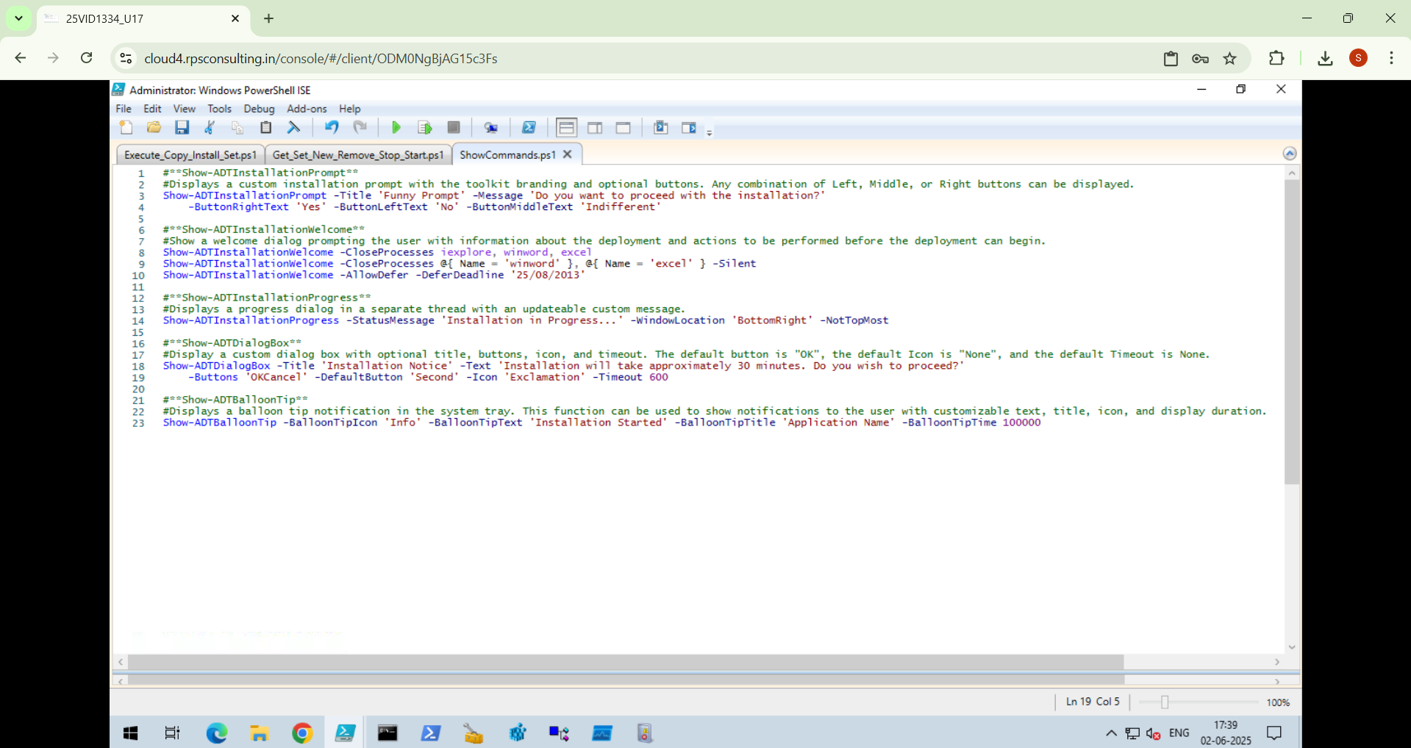
9
Commands
2024 - RPS Consulting all rights reserved

Slide 10
10
Resources / References
https://github.com/PSAppDeployToolkit/PSAppDeployToolkit
https://psappdeploytoolkit.com/docs/reference/functions/Show-ADTInstallationPrompt
https://openai.com/index/chatgpt/
https://learn.microsoft.com/
2024 - RPS Consulting all rights reserved

